Slide 1

Introduction to Artificial Neural Networks and Deep Learning
Mehdi Mashayekhi
Department of Integrated Systems Engineering

Slide 2
Introduction
Introduction
How DL algorithms work?
Applications

Slide 3
Introduction
History:
The first Artificial Neural Network was invented in 1958 by Frank Rosenblatt.
It was intended to model how the human brain processed visual data and learned to recognize objects.
The term Deep Learning was introduced to the machine learning by Rina Dechter in 1986.

Slide 4
Introduction
History:
Szegedy C, et al. first introduced The Inception deep convolutional architecture and called GoogLeNet or Inception-v1. Inception-v1 won the Imagenet Large Scale Visual Recognition Challenge 2014 (ILSVRC2014) .
AlexNet in 2012 significantly outperformed all the prior competitors and won the ImageNet Large Scale Visual Recognition Competition (ILSVRC).
ResNet won the 1st place on the ILSVRC 2015 classification task.

Slide 5
How DL algorithms work?
Deep Learning

Slide 6
How DL algorithms work?
Components:
Nodes: Contain datapoints. The nodes in the firs layer are the independent variables. The last layer contains the dependent variable or response.
Layers: They contain a collection of nodes depending on the DL model. In the picture, each column represents a layer.

Slide 7
How DL algorithms work?
Components:
Activation Functions: The value of each node is obtained by mapping previous nodes in the activation function. In the picture, each line represents mapping by an activation function.
Weights: To obtained a value for a node in the (except for input layers), mappings of previous nodes are weighted.

Slide 8

How DL algorithms work?
Loss Functions:
Mean Squared Error:
$$MSE= \frac{\sum_{i=1}^{n}{{\left(y_{i}−{\hat{y}}_{i}\right)}^{2}}}{n}$$
Mean Absolute Error:
$$MSE= \frac{\sum_{i=1}^{n}{\left|y_{i}−{\hat{y}}_{i}\right|}}{n}$$

Slide 9
How DL algorithms work?
Hyperparameter | Number of layers | Activation function | Dropout rate | Learning rate | # of Epochs
Type | Discrete | Categorical | Discrete | Discrete | Discrete
Level #1 | 32 | Softmax | 0 | 0.01 | 1
Level #2 | 64 | Softplus | 0.1 | 0.02 | 2
Level #3 | 128 | Softsign | 0.2 | 0.03 | 3
Level #4 | … | Relu | 0.3 | 0.04 | …
Level #5 | 3200 | Tanh | 0.4 | 0.05 | 15
Level #6 |  | Sigmoid | 0.5
Level #7 |  | Hard_sigmoid
Level #8 |  | Linear

Slide 10



How DL algorithms work?

Slide 11
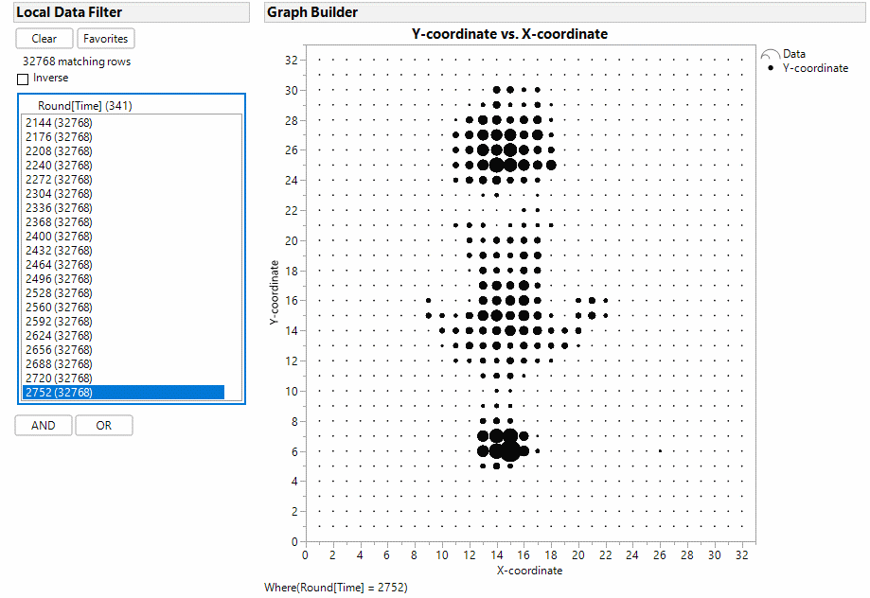
Applications

Slide 12
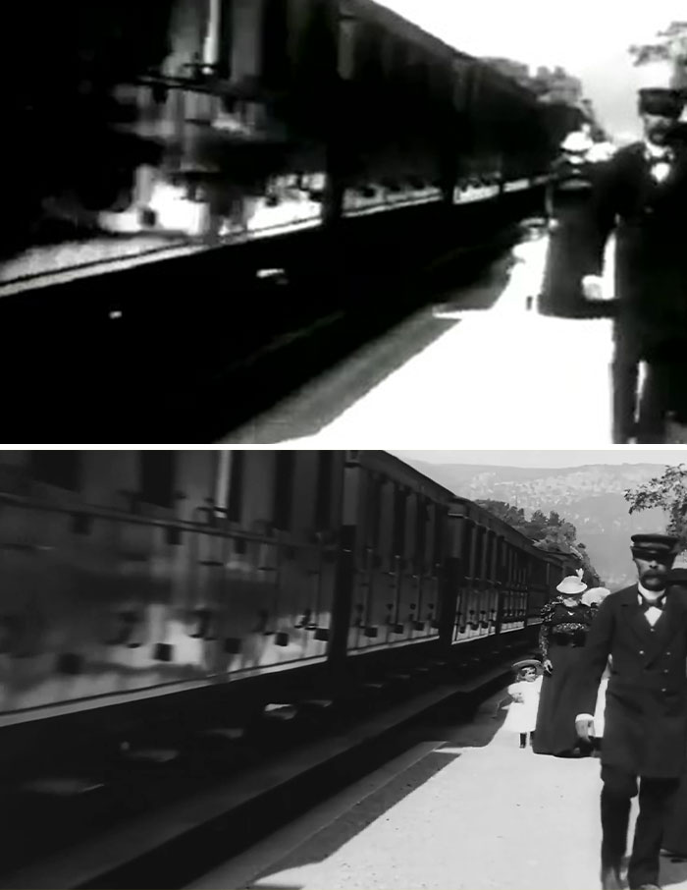
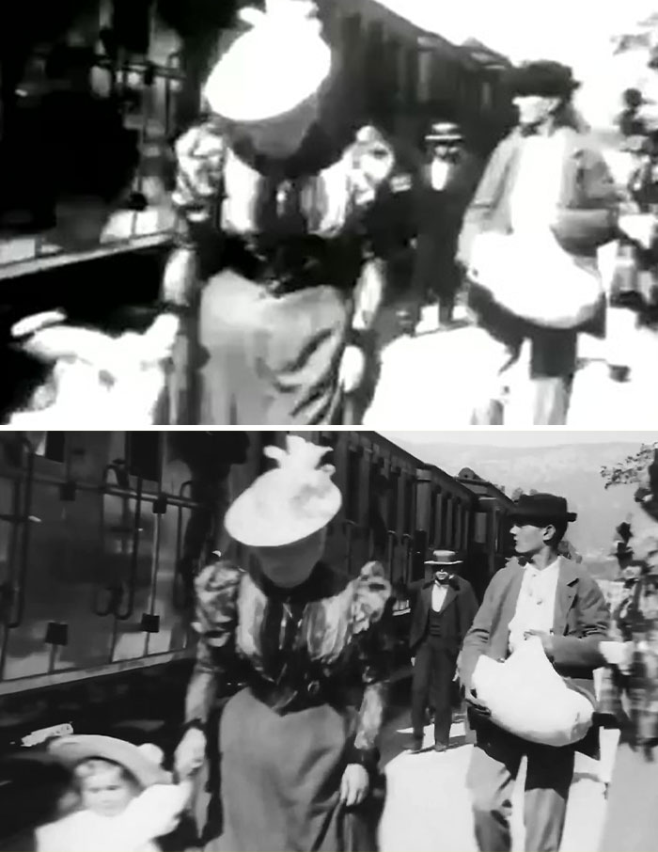
Applications

Slide 13
Thank You

